Slide 1





KURUKSHETRA
Protecting User Password Keys at Rest
Presented by:
Kurukshetra team

Slide 2

CONTENT
1 | The kurukshetra
2 | Unique Idea
3 | Features
4 | Process Flow
5 | Technologies
6 | Kurukshetra team
7 | Marketing mix
8 | Thank you

Slide 3

The Kurukshetra
Securely encrypts and decrypts user-selected files and folders using AES-256 encryption.
Generates File Encryption Key (FEK) and password using Key Derivation Function.
Ensures data access and decryption by authorized individuals with correct passcode.
Discusses application workflow, AES-256 encryption, KDF usage, cryptographic decisions, open-source library, system routine usage, and testing scenarios.
Provides access to source code repository.
Demonstrates strong implementation of cryptographic standards for data security and secrecy.

Slide 4




Unique Idea
Provide a secure method for encrypting and decrypting files, ensuring user password keys are protected at rest.
Objective
Implement a user-friendly application for encryption and decryption using a secure passphrase.
Solution
Encryption and decryption of files using AES, validation of passphrases, and user-friendly GUI.
Key Features

Slide 5







Features
User-Friendly Interface
Strong Encryption
Strong Encryption
Secure Key Derivation
Passphrase Validation
Progress Indicators

Slide 6
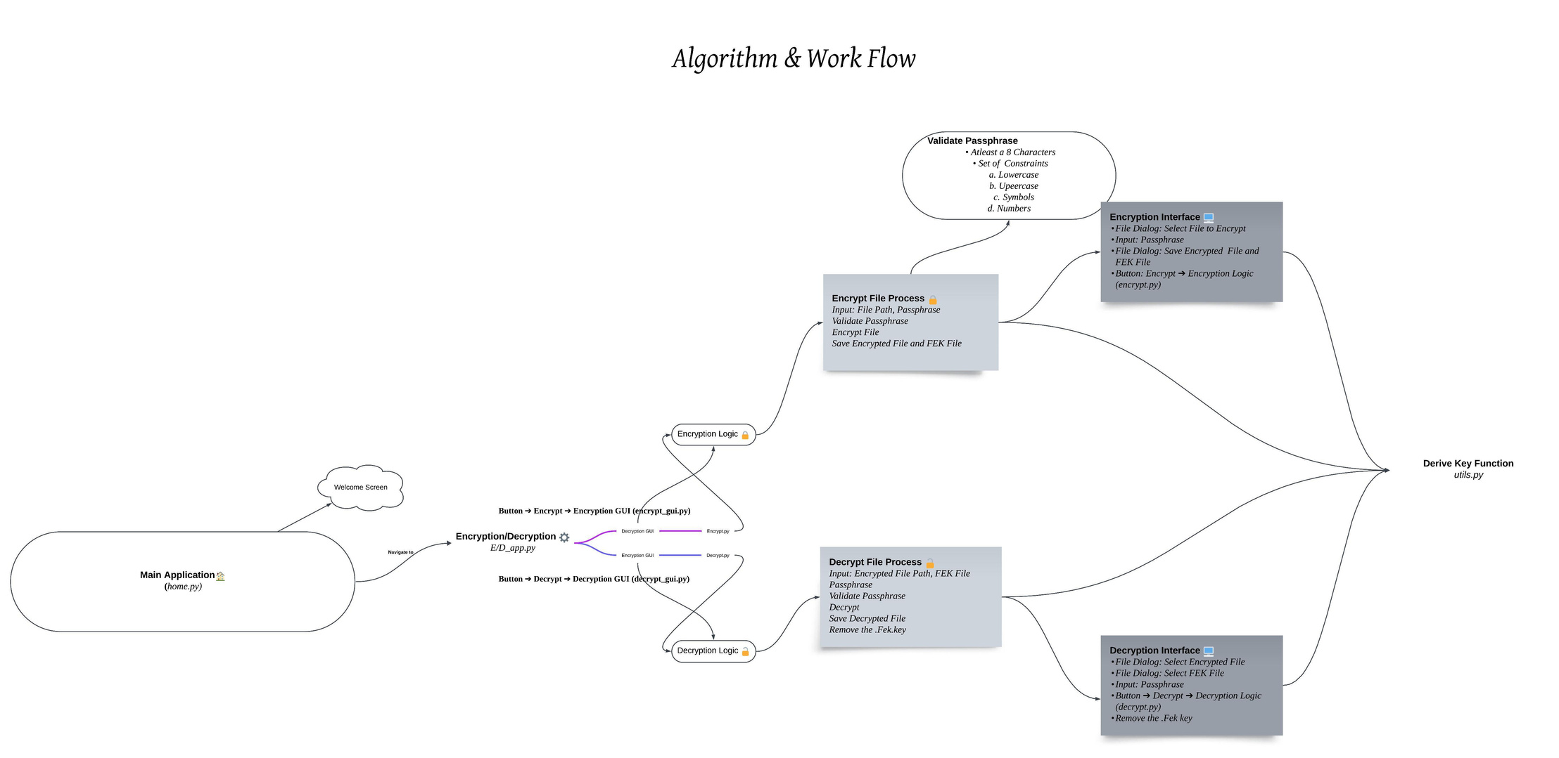

Process Flow

Slide 7
Running the project
On Windows:
Double-click ‘Kurukshetra.bat’ to start the application.
The Script will change the directory to ‘Internship-Main’ and run the ‘home.py’ script
On Linux:
Open a terminal and navigate to the project directory:
cd Kurukshetra-Main
Make the script executable:
chmod +x kurukshetra.sh
Run the Script:
./kurukshetra.sh

Slide 8
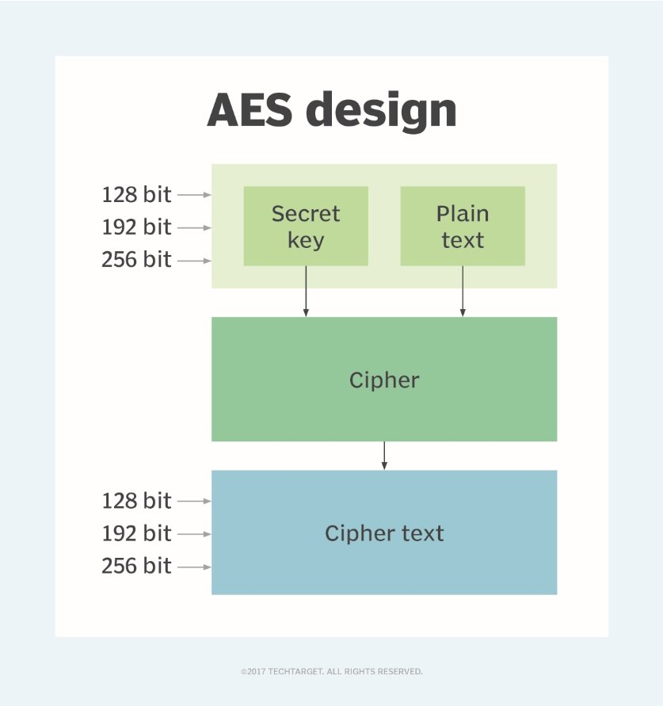
AES-256 Algorithm
The Advanced Encryption Standard (AES) is a symmetric block cipher chosen by the U.S. government to protect classified information.

Slide 9
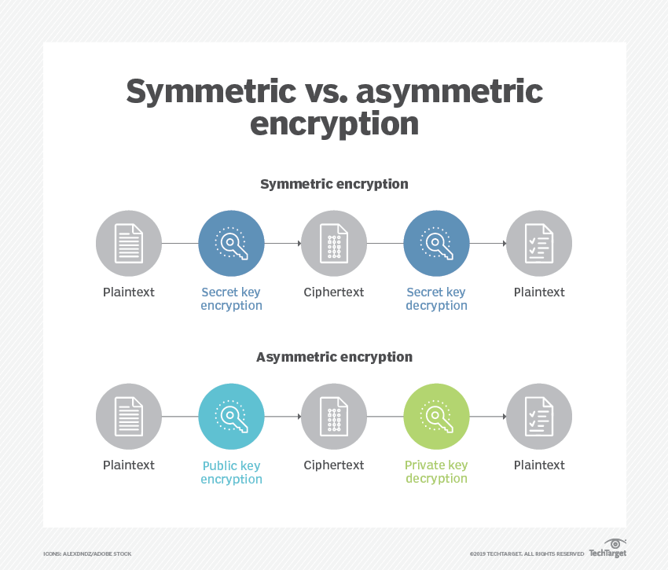

Slide 10
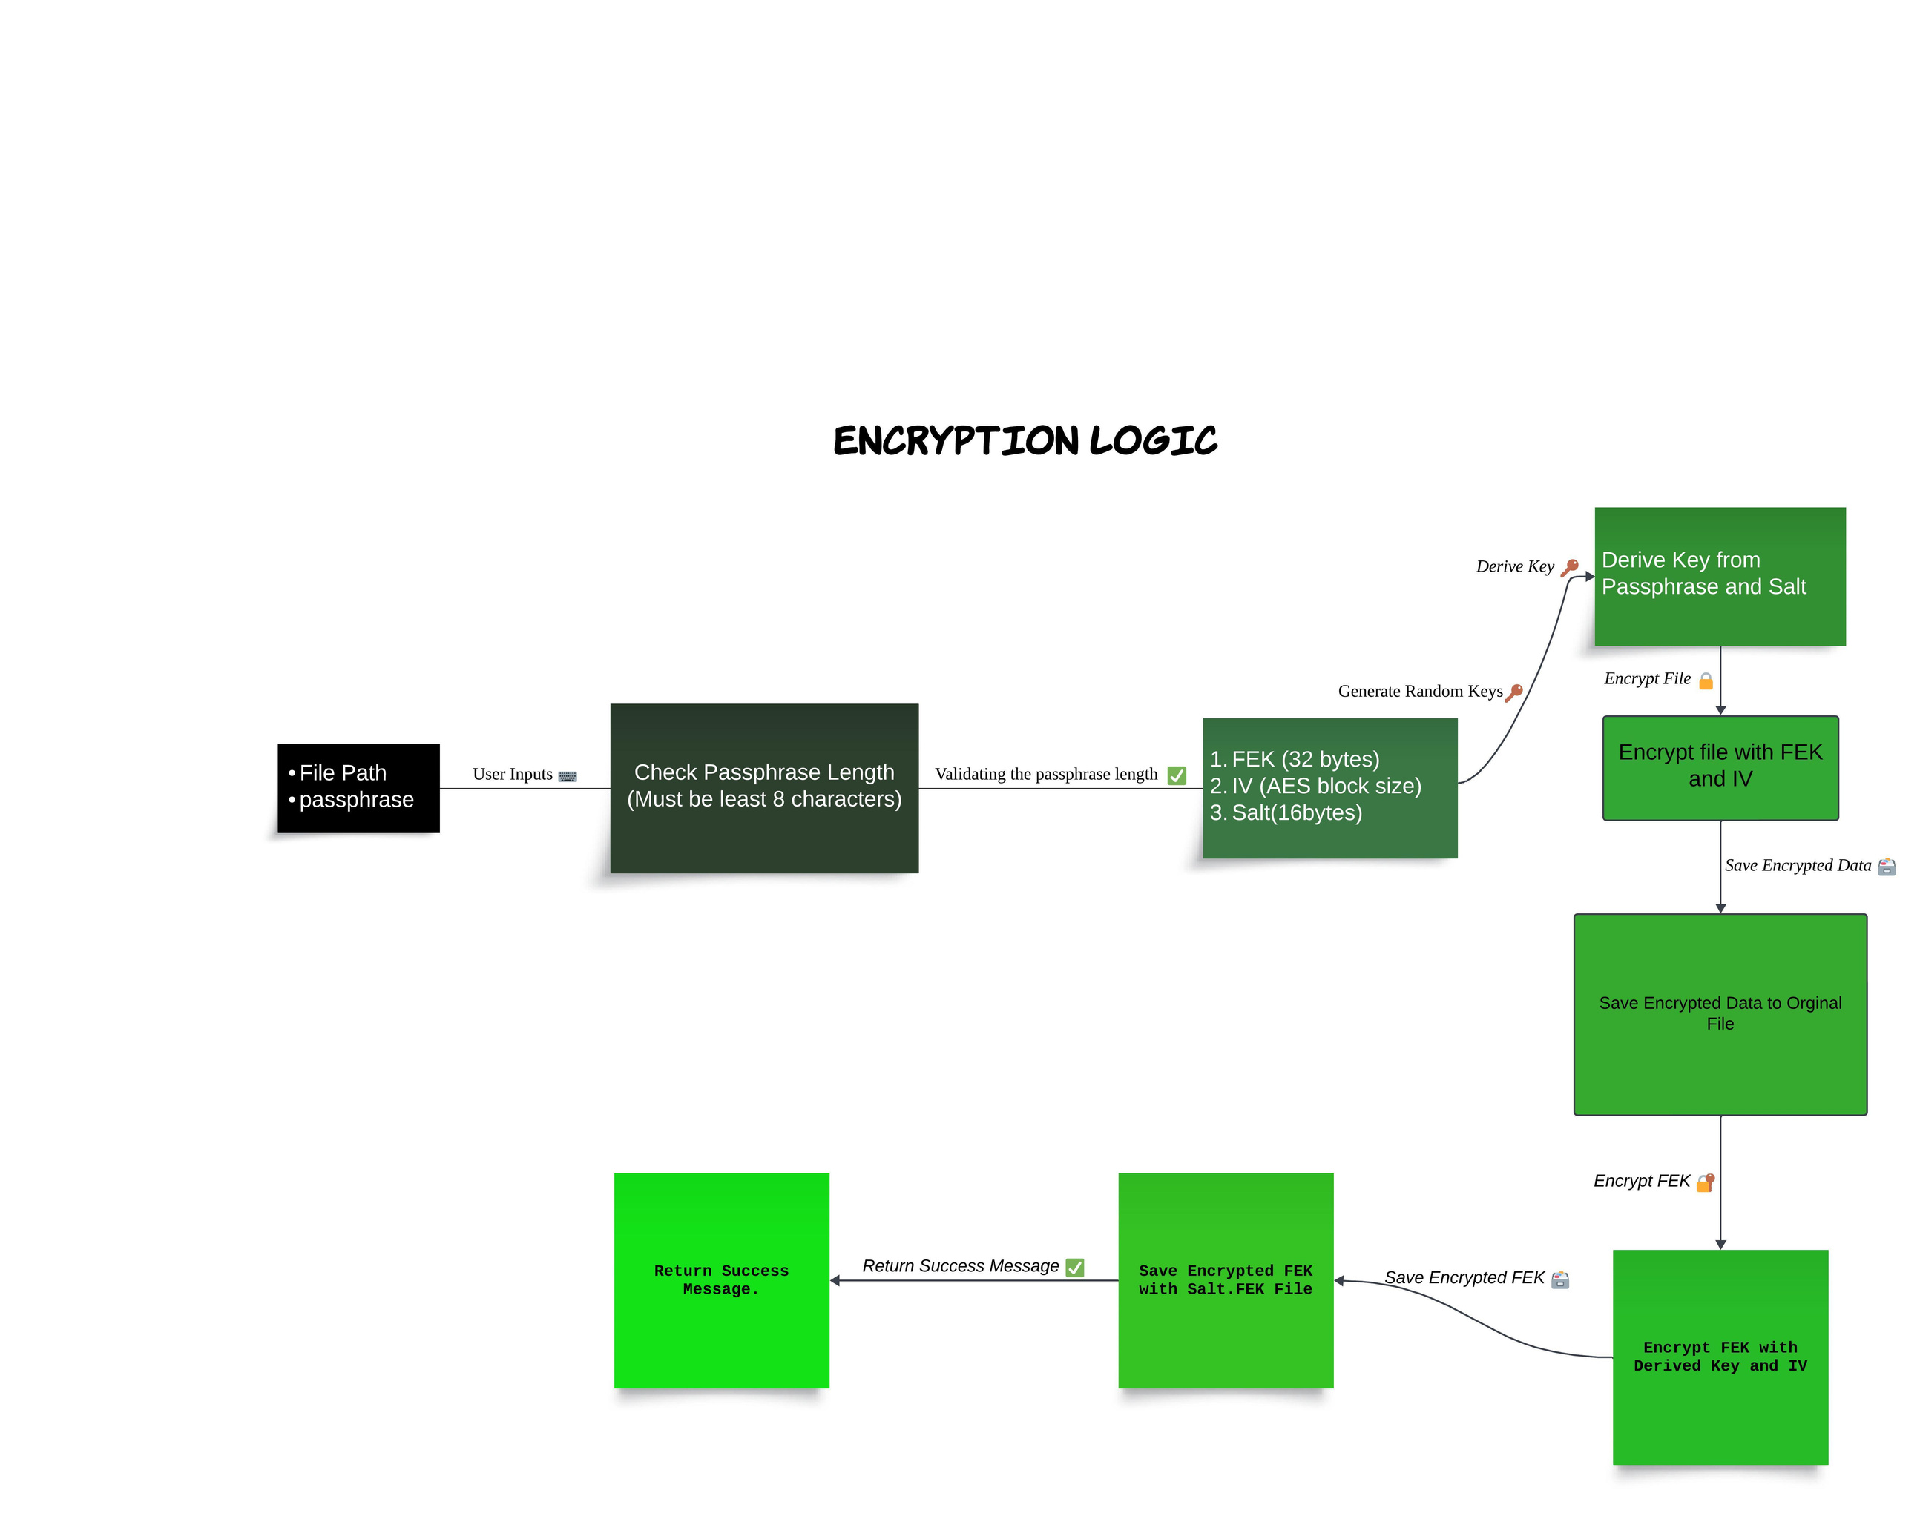

Encryption Logic

Slide 11
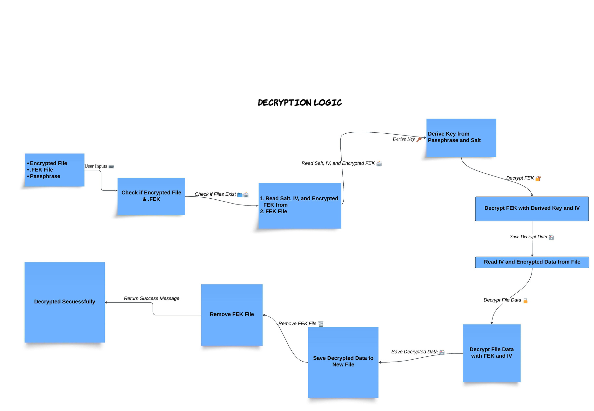

Decryption Logic

Slide 12
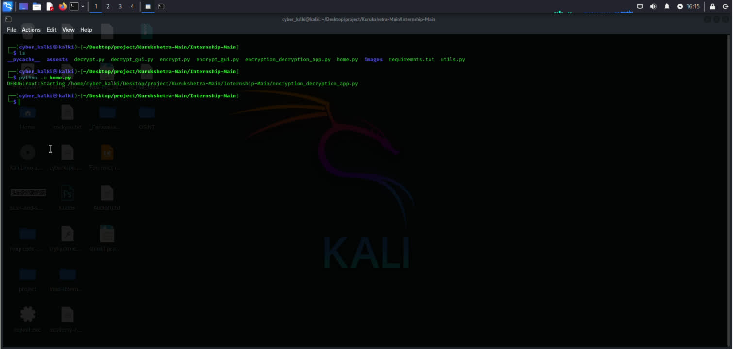
DEMO

Slide 13



Technologies
Python
PIL (Pillow)
PyCryptodome
utils
CustomTkinter

Slide 14


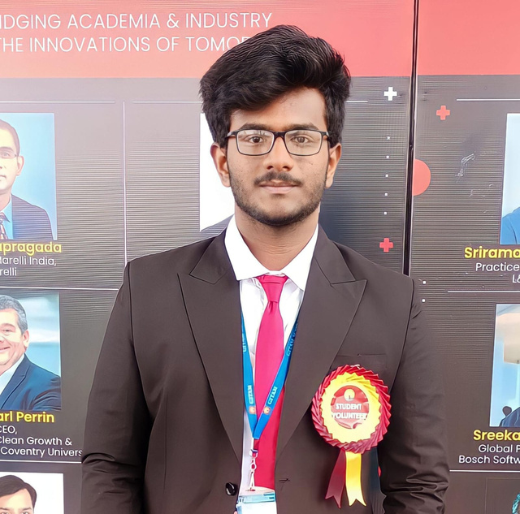
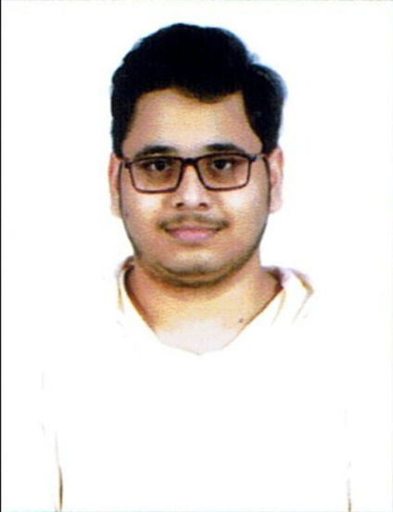
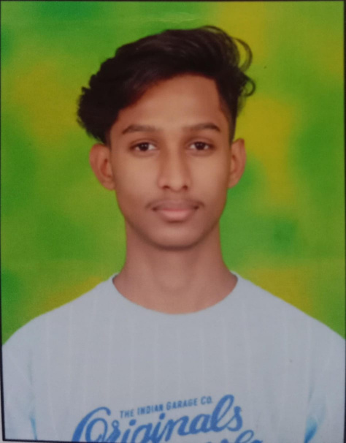
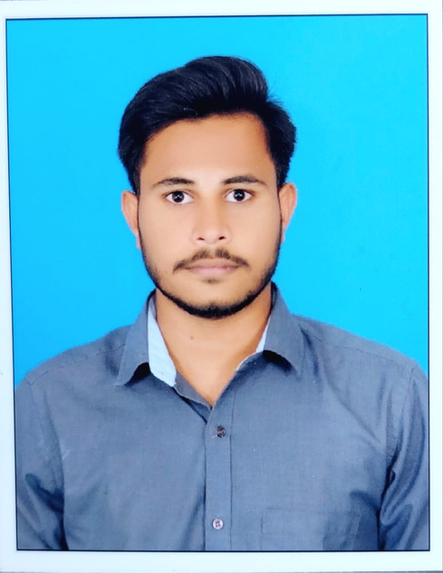
KURUKSHETRA
TEAM
Barenkala Bhuvan Subramanyam
Sattaru Venkata Abhilash
Eswarapramod Edara
Eediga Vishnu
Yugandhar Reddy

Slide 15



